Slide 1
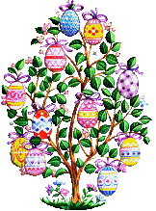
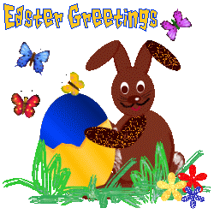
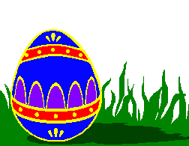
http://www.history.com/topics/history-of-easter
http://www.theholidayspot.com/easter/easter_symbols.htm

Slide 2
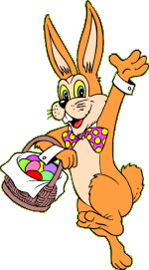
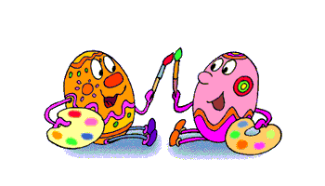
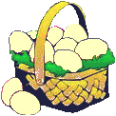
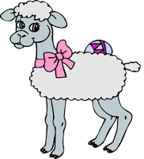
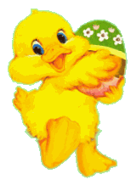
VOCABULARY
bunny
Easter eggs
basket
lamb
chick
chocolate

Slide 3
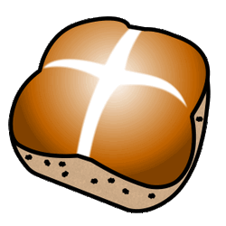
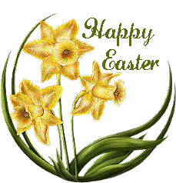
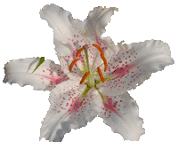
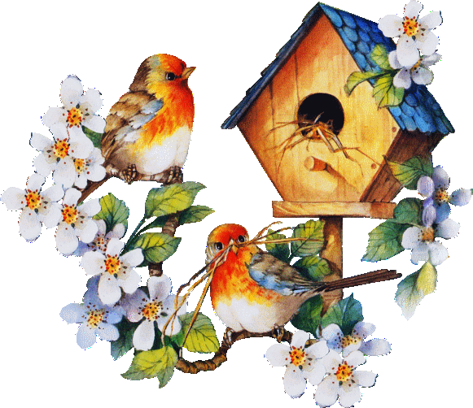
VOCABULARY
hot cross bun
daffodil
lily
spring
bible
cross

Slide 4
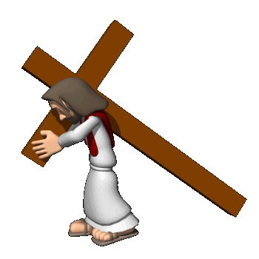
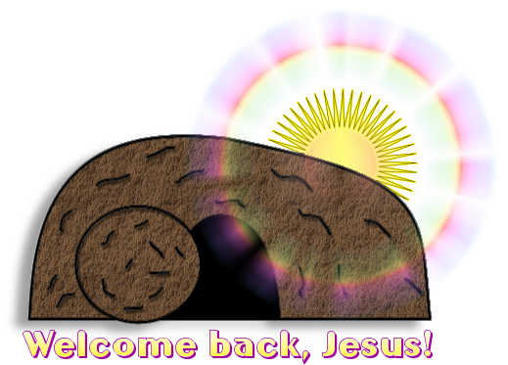
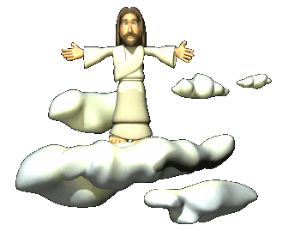
HISTORY
Good Friday honours the day he was crucified.
Holy Saturday commemorates the day that Jesus Christ lay in the tomb.
Easter Sunday celebrates Jesus Christ ‘s resurrection.

Slide 5
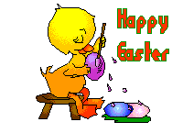
TRADITIONS
In Britain, it is traditional to eat warm hot cross buns on Good Friday. They have a cross of icing on the top to remind people of Christ.
Easter Saturday is traditionally spent decorating Easter eggs.
On Easter Sunday Christians attend mass on a hill side so everyone can see the sun rise.

Slide 6
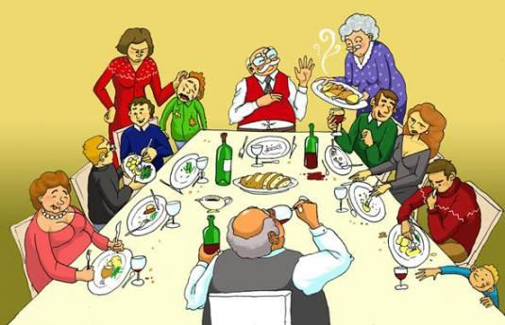
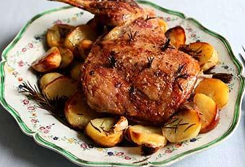
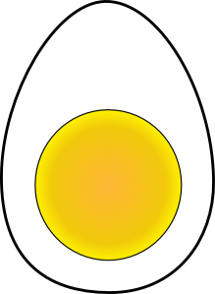
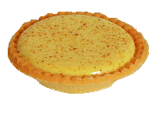
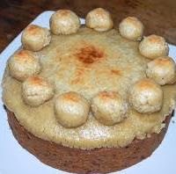
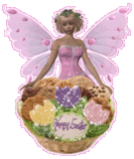
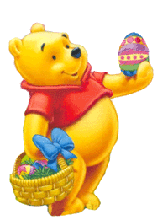
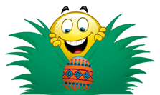
TRADITIONS
Then, families gather together to enjoy special food:
Boiled eggs
Roast lamb
Custard tarts
Easter biscuits
Finally, Simnel cake is baked for tea.
Later, children hunt for Easter eggs that have been mysteriously hidden all over the house and garden by the Easter bunny.

Slide 7
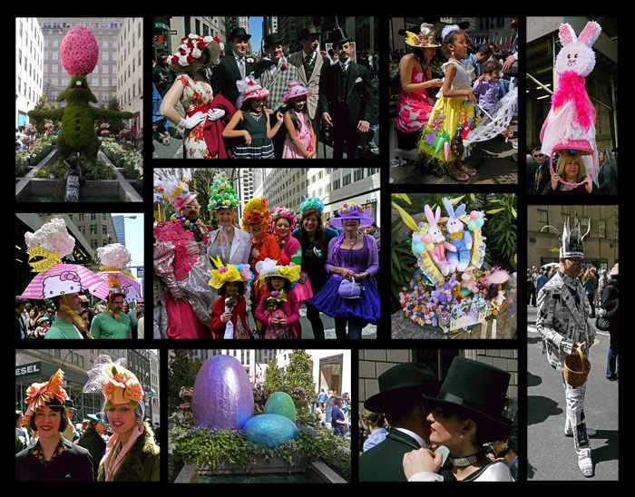
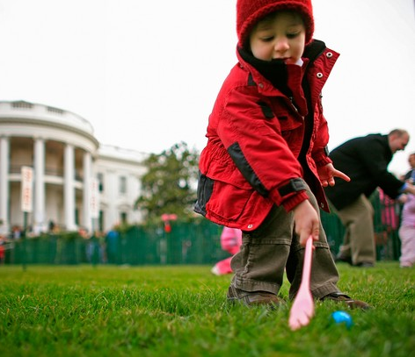
TRADITIONS
The Easter Parade tradition is very popular in the USA. People often wear decorated bonnets and hats.
On Easter Monday, egg rolling is a traditional game played with boiled, decorated eggs. In the USA it is held on the White House lawn.

